Slide 1
CODE AND DESIGN SMELLS
TOPIC 10
UTM-SERG Research & Consultancy Team
School of Computing
Faculty of Engineering
Universiti Teknologi Malaysia
UTM, Skudai, Johor.

Slide 2
AGENDA
Agenda 1: Introduction
Agenda 2: Resources
Agenda 3: Representation
Agenda 4: Implementation
Agenda 5: Summary

Slide 3
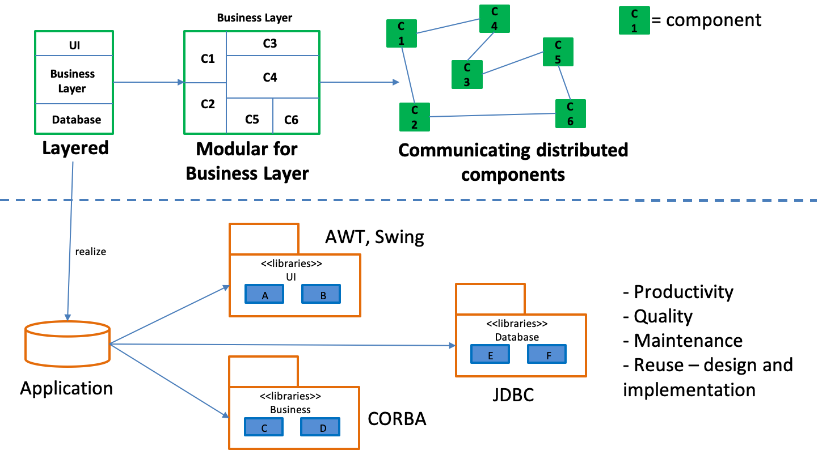
INTRODUCTION
Working product
output
Optimization process
Code and Design Smells
A hint of anomaly found in design
And code

Slide 4
INTRODUCTION
Problems
How do we detect an anomaly in software system to support a
Software-less bugs?
WHAT
WHY
HOW
Method to detect anomaly
in code and design
Detect weaknesses
Optional-to-compulsory
process
To improve code and design
Decrease a possibility of bugs
Improve quality
Indicate weakness
Design level
Code level
Important – Code and design smells DO NOT prevent system from functioning

Slide 5
CODE SMELLS
Bad smells is not indicating an existing of bugs and do not prevent the software
From functioning.
Reveal only a surface of problems in the software (not in a deep level)
Usually involve in CLASS, METHOD, STATEMENT
Do not address overall design decisions

Slide 6
CODE SMELLS

Slide 7
CODE SMELLS: DATA CLASS

Slide 8
CODE SMELLS: DATA CLUMPS

Slide 9
CODE SMELLS: FEATURE ENVY

Slide 10
CODE SMELLS: GOD CLASS

Slide 11
DESIGN SMELLS
Usage
Relations
Inheritance
Package, Subsystem, Layers
Unused classes
Tree like structures
Cycles between classes
Visibility of usage relations
Refused parent bequest
Subclass without redefinition
Tradition breaker
Refactoring
Speculative generality
Bad smells can be detected by using EXPERIENCE, METRICS and AI

Slide 12
EXAMPLES

Slide 13
SUMMARY
Indicator that something is wrong about the software (design and code level)
Lead to Technical Debt
Refactoring is on of the technique to reduce code and design smells

